Slide 1
Automated Analysis of Urbanization Impact on Water Quality
Team 4: roujia, qingyuel, zxuyuan

Slide 2
Introduction & Project Goals
Introduction:
With increasing human activities and changes in land use patterns, the impact of land cover types on water quality is becoming increasingly evident. In this context, we have chosen Michigan as our study area to explore the relationship between land cover types and water quality.
Project Goals:
Represent monitoring points with associated sediment concentration data
Identify different land cover types in Michigan
Identify the relationship between water quality and land covers

Slide 3
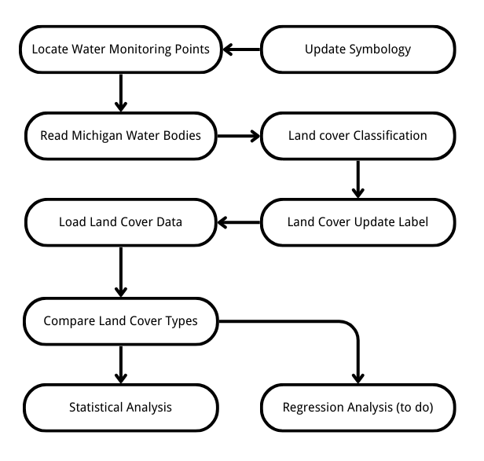
Workflow Diagram

Slide 4
Database
USGS, USGS Water-Quality Monthly Statistics for Michigan
United States Census Bureau, Cartographic Boundary Files
Commission for Environmental Cooperation, North American Land Cover, 2020 (Landsat, 30m)
ESRI, USA Detailed Water Bodies
SENTINEL-2 Level-2A
Pre-trained deep learning model
Oponeo to automatically download sentinel-2 data

Slide 5
Codes & Map Output

Slide 6
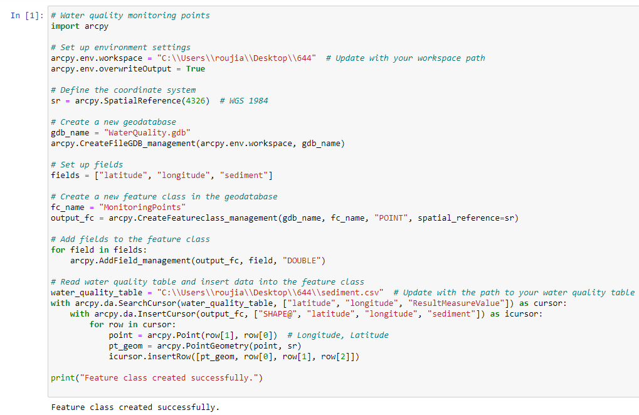
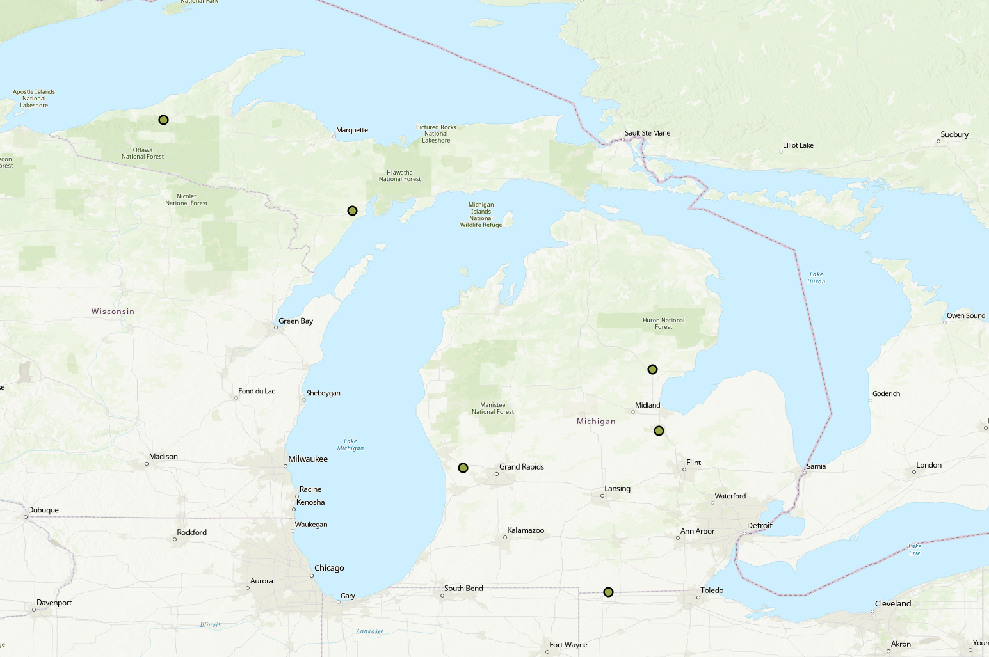
Import Water Quality Monitoring Points
Notes:
We created a geodatabase to store monitoring points and defined the coordinate system. These points represent locations where water quality measurements have been taken. The data is read from the water quality table containing latitude, longitude, and sediment concentration.

Slide 7
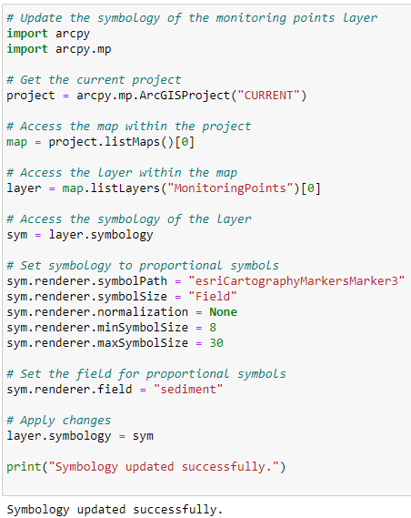
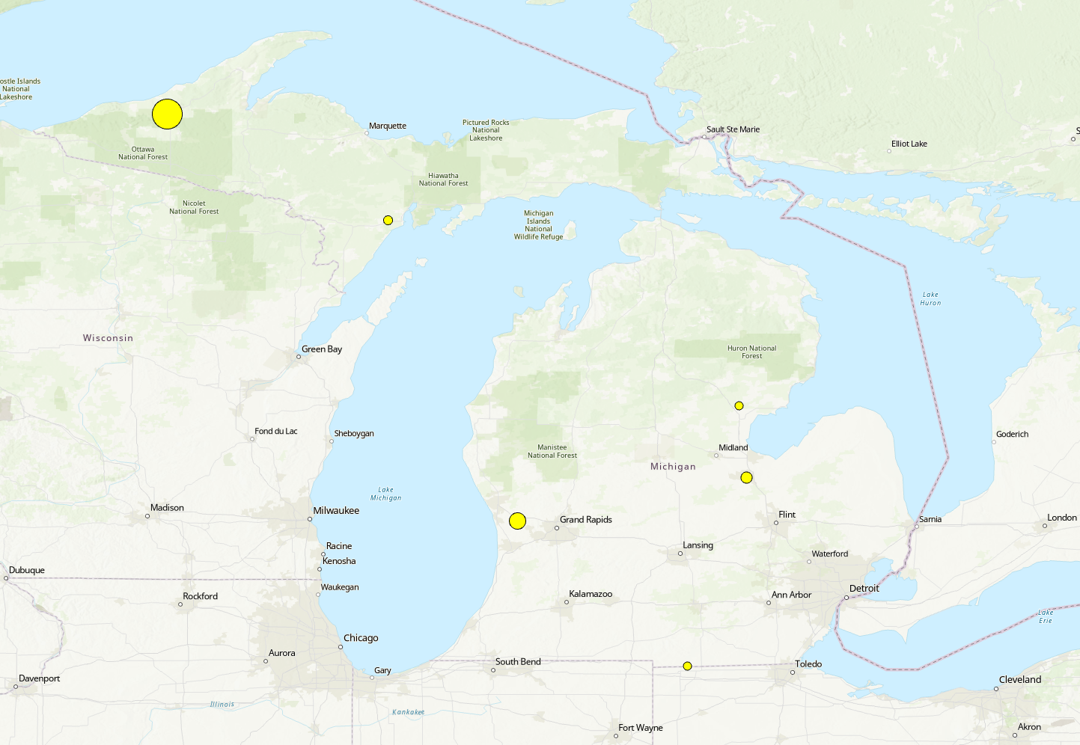
Update the symbology of the Monitoring Points layer
Notes:
Once the monitoring points were added, we updated their symbology. We set the symbology to use proportional symbols based on the sediment measurement. The size of the symbols corresponds to the sediment measurement for better visualization.

Slide 8
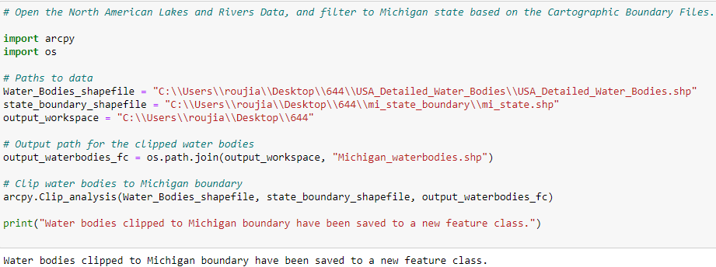
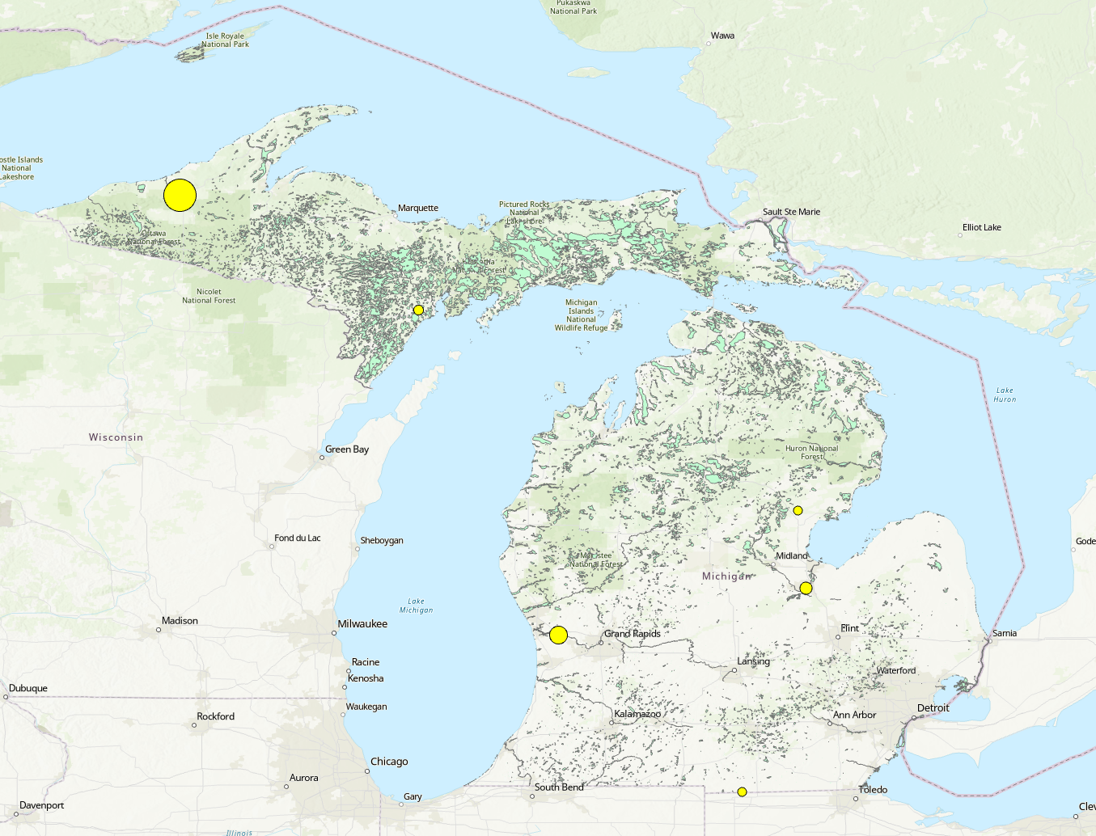
Clip the water bodies to the Michigan boundary
Notes:
Next, we filtered water bodies data to focus on Michigan state, using the state boundary from U.S. Census.

Slide 9
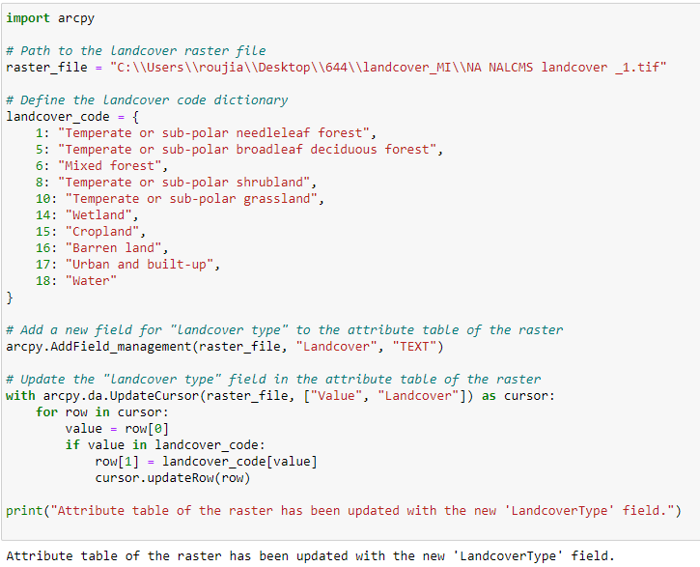
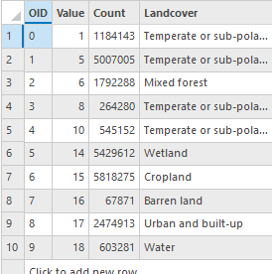
Import Land-cover Data
Notes:
In this part, we updated the attribute table of the land cover raster. We added a new field to it and populated it with the corresponding land cover types based on the land cover code, provided by North American Land Change Monitoring System.

Slide 10
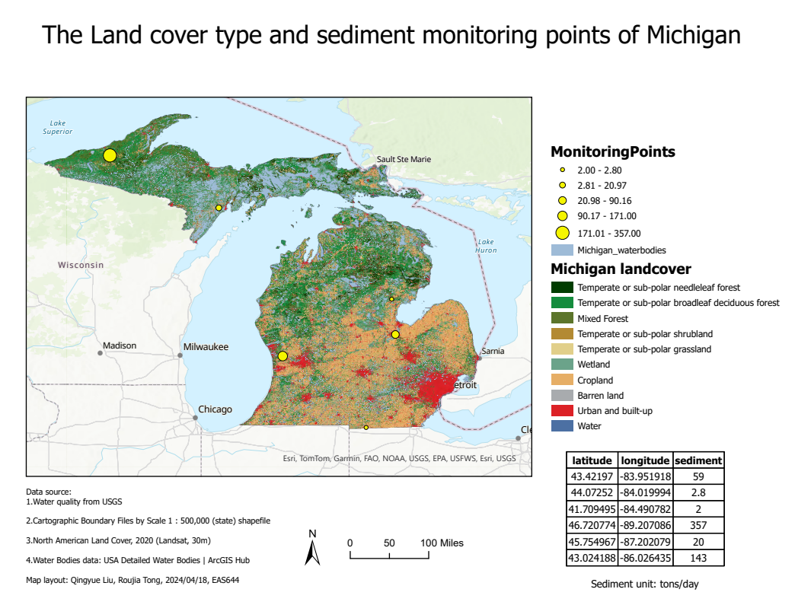
Map layout

Slide 11
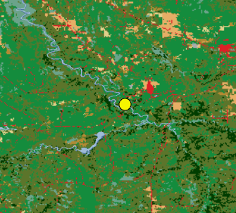
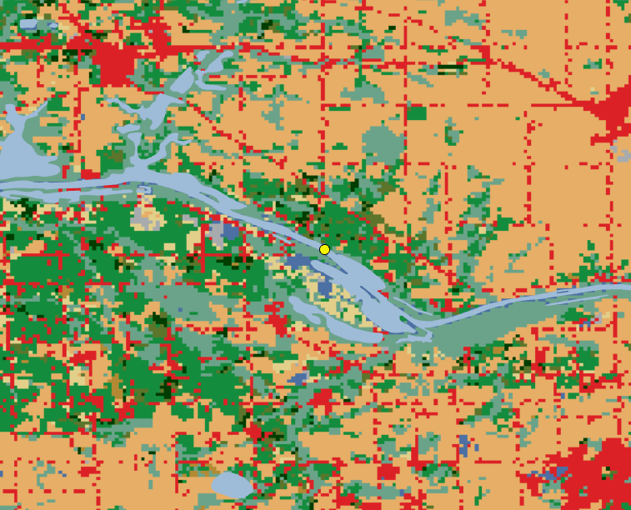
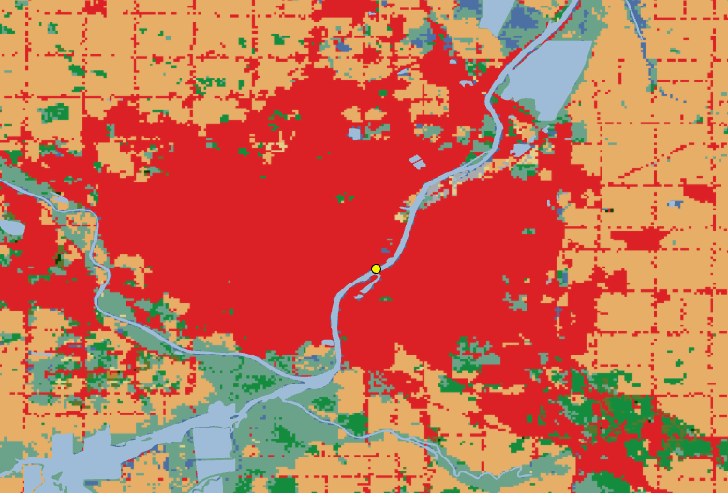
Monitoring points
USGS-04040000
USGS-04157005
USGS-04119400
357 tons/day
Ontonagon River Near Rockland
143 tons/day
Grand River
Near Eastmanville
59 tons/day
Saginaw River
at Holland Avenue
Notes:
Here are monitoring points results combined with the land cover types. We sort the points by sediment concentration.

Slide 12
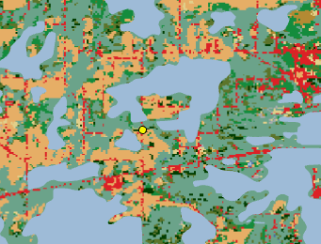
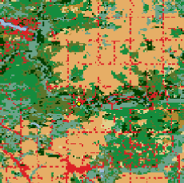
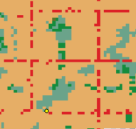
Monitoring points
USGS-04059500
USGS-04142000
USGS-04177080
20 tons/day
Ford River Near Hyde
2.8 tons/day
Rifle River Near Sterling
2 tons/day
E BR ST Joseph R at Territorial RD NR Waldron
Notes:
We find out that mixed forest and deciduous forest were more distributed in places with high sediment concentration. The places with low sediment are mostly urban, grass land and built-up.
In addition to considering the land cover type factor, the difference of topographic elevation will also cause the change of sediment concentration.

Slide 13
Land cover identification using Sentinel-2

Slide 14
Why we need to manually classify the land cover
Our research needs to focus on the land cover classification of each study site But directly using this NORTH AMERICAN LAND COVER DATA does not satisfy our requirements,
It is annual data and water sediment is greatly affected by the month;
The resolution of this data is insufficient and its delineation of small areas is very broad, e.g., all of the land cover within 5 mile is classified as vegetation.
Notes:
Our research needs to focus on land cover classification and directly using the north american land cover is not suitable in our study. Because firstly, water sediment is monthly data and it suffers from seasonality so directly using annual data is not gonna be accurate. Secondly, the resolution of the public data is not sufficient in our setting. Therefore, we should try to classify the land cover ourselves.

Slide 15
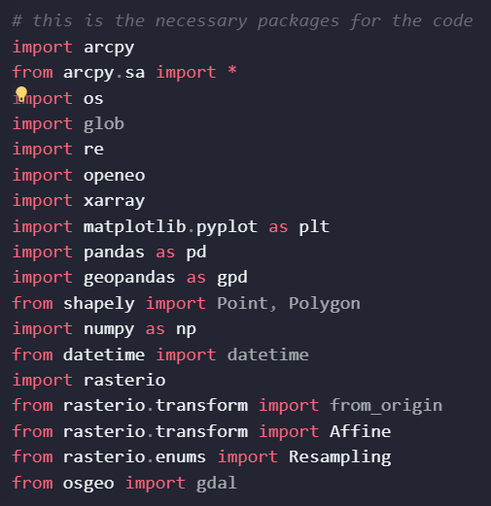
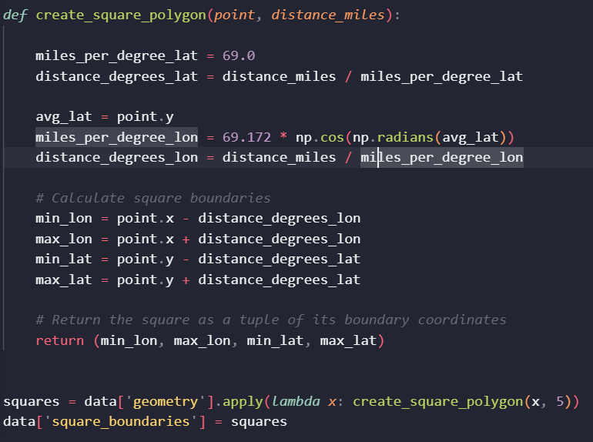
Packages and Requirements
Notes:
These are the packages we are using in our classification. We use arcpy to use geospatial analysis and other analysis tools, geopandas to process and use shapefile, rasterior to use remote sensing tiff files. To process the result, we use 5 miles buffer of each study point and use geopandas to construct the attribute.

Slide 16
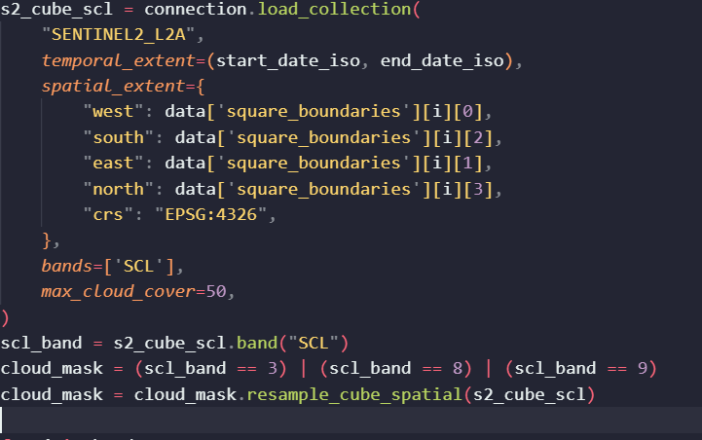
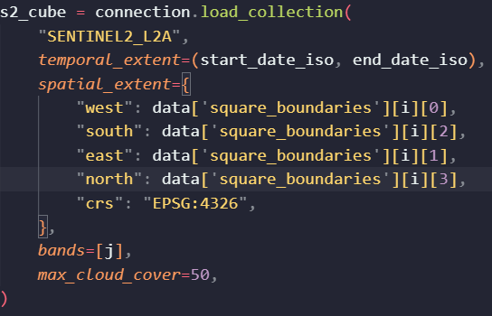
Downloading the remote sensing image
Notes:
Instead of downloading each Sentinel 2 file directly, we first filter out the cloudy images by the SCL band in the sentinel 2 data and then select the date closest to our on-site water sediment study point and then download the file using python.

Slide 17
Classification Method
We decide to use unsupervised classification method on each study cite with 5 miles buffer and this is because:
We tried to use pre-trained deep learning model on esri but the result is not good and this is because the publicly available version of the Sentinel 2 data has different resolutions in the bands and this would cause the estimation to be inaccurate;
We also considered a large-scale unsupervised classification method, but this method has a very large running time, so we have to abandon it.
Constructing a deep learning model on our own requires massive data collection and a lot of GPU in training, which is beyond our time and effort.
Therefore, we choose to use unsupervised classification on each study site and then use different indices to extract the land cover type and automatically label each classified region with the correct label.

Slide 18
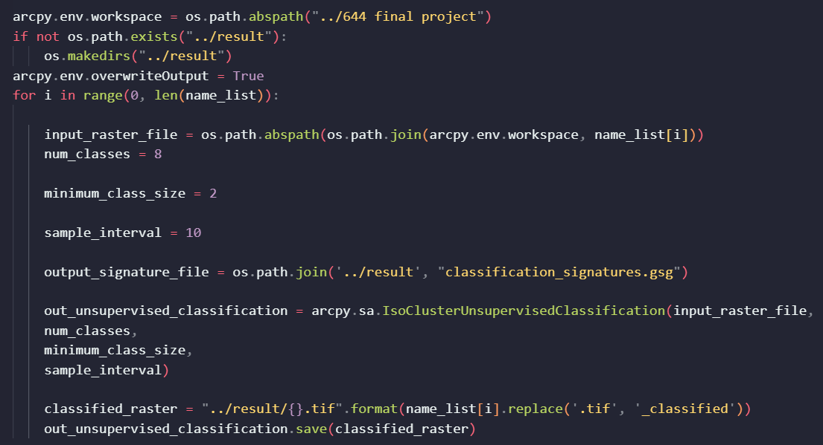
Notes:
Here we skip some operations to clean the data and here is our main algorithm. We use esri's iso cluster unsupervised training method to automatically classify the result, and then we export the result to tif and shapefile.

Slide 19


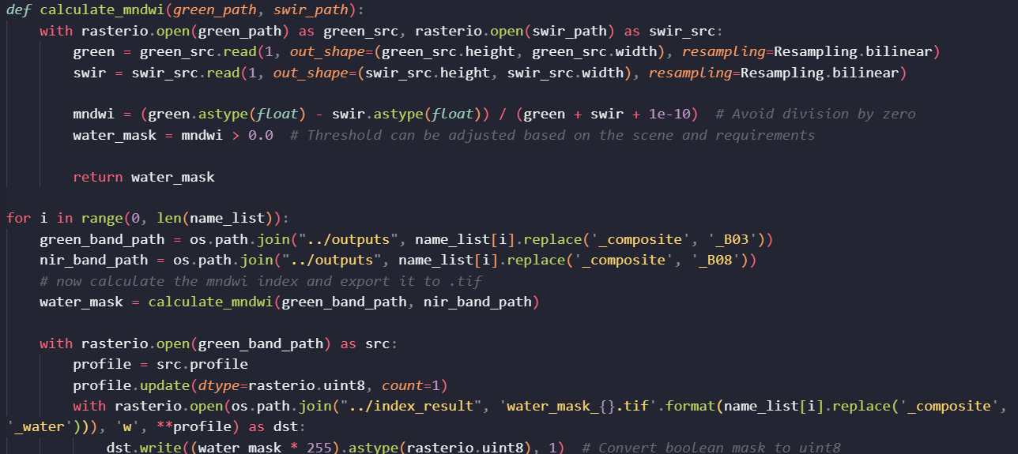
Automatically label the generated classification
Detecting Water:
For Sentinel-2, you can use Band 3 (Green, 560 nm) and Band 8 (NIR, 842 nm).
Notes:
To automatically label the generated classification, we first use the NDWI to extract the water region in the classified map and here is our code in python.

Slide 20
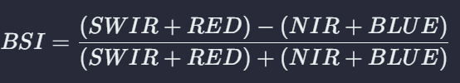





Similarly we construct other indices
Bare Land Area Detection: Sentinel-2 Bands: SWIR (Band 11, 1610 nm or Band 12, 2190 nm), Red (Band 4, 665 nm), NIR (Band 8, 842 nm), and Blue (Band 2, 490 nm).
Urban Area Detection: For Sentinel-2, Band 8 (NIR, 842 nm) and Band 11 (SWIR, 1610 nm)
Vegetation Area Detection: For Sentinel-2, Band 8 (NIR, 842 nm) and Band 4 (Red, 665 nm) with index > 0.5 as tree and between 0.2 to 0.5 as grass areas
Snow Area Detection: For Sentinel-2, use Band 3 (Green, 560 nm) and Band 11 (SWIR, 1610 nm)
Moisture Vegetation Area Detection: For Sentinel-2, use Band 8 (NIR) and Band 11 (SWIR, 1610 nm) or Band 12 (SWIR, 2190 nm).
Notes:
Similarly, we generated other indices to partition our land cover. Finally, after obtaining these indices, we used a greedy algorithm to assign the most likely attribute to the final label for the land cover. Then we can plot the result and check the relationships of these factors.

Slide 21
Relationship between Water Quality and Land Cover Types

Slide 22
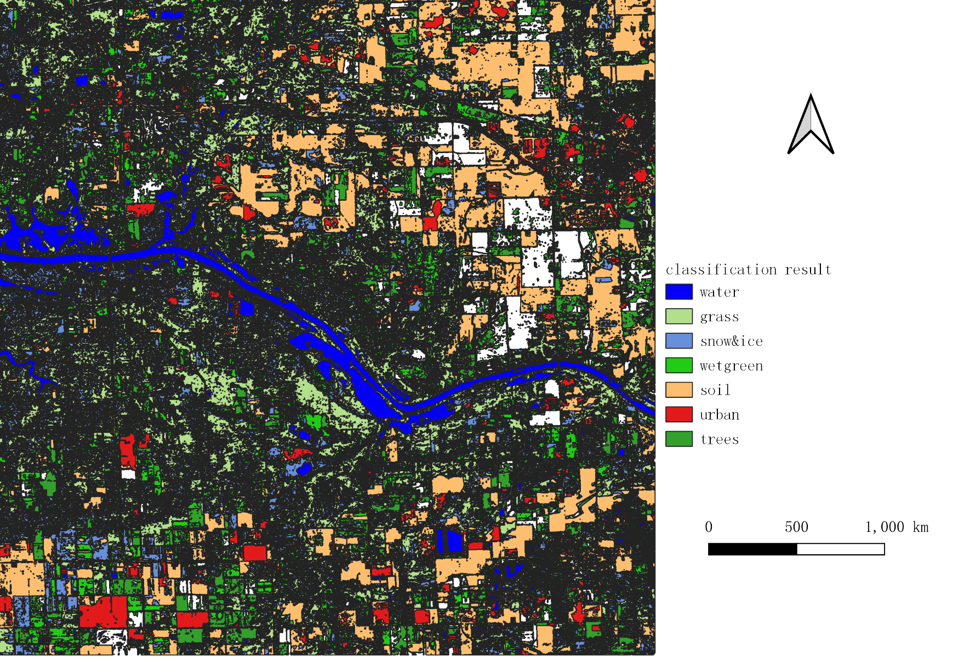
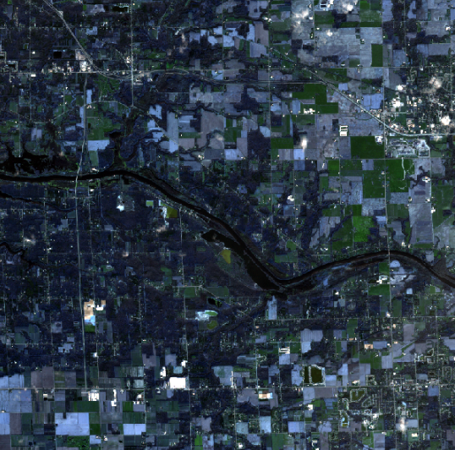
Notes:
Here is an example of the classified result and we can see that the classification is clearly aligned with the actual remote sensing result.

Slide 23
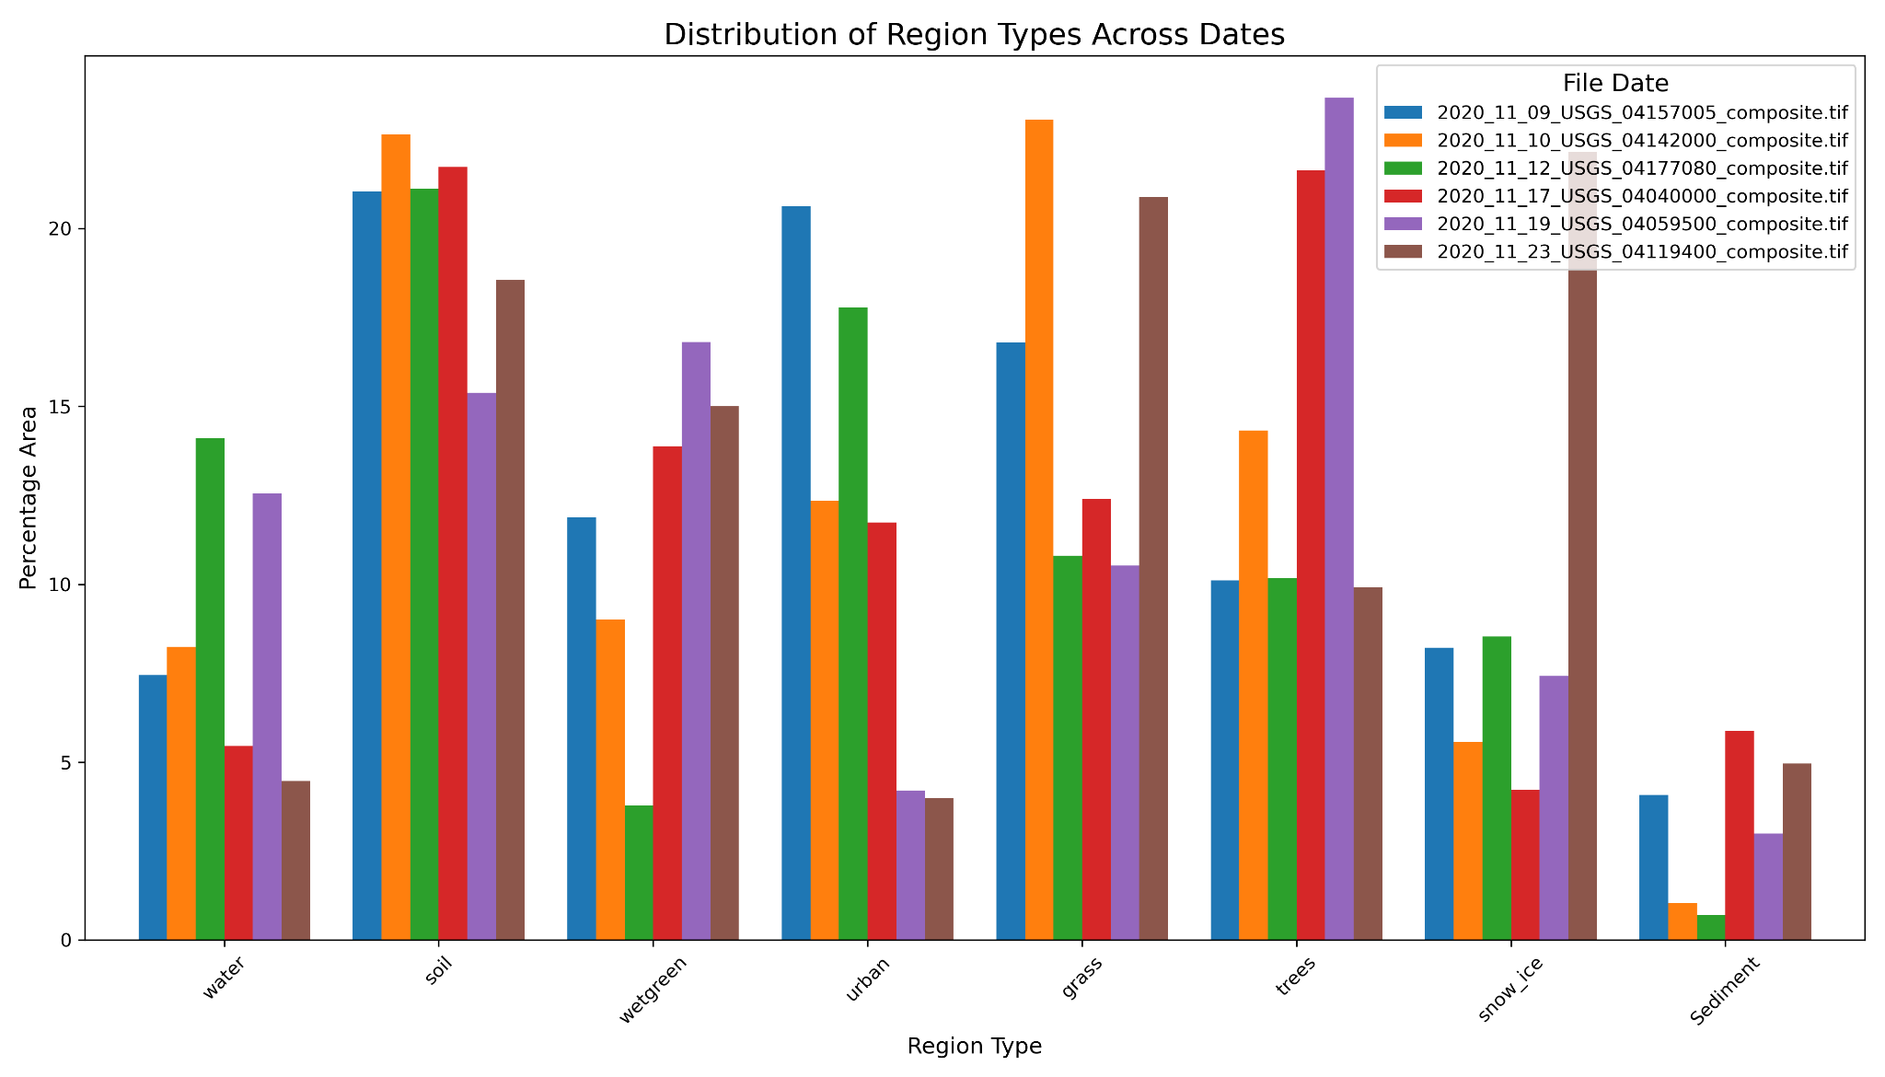
This is the result of our classification results and we statistically check to see the proportion of different types of land cover and water sediment in each area, but since we don't have a large number of samples in the study at this point, we need to further run codes in all the samples and use regression to look at the effect of different types of land cover on water sediment.
Notes:
This is the result of our classification results and we statistically check to see the proportion of different types of land cover and water sediment in each area, but since we don't have a large number of samples in the study at this point, we need to further run codes in all the samples and use regression to look at the effect of different types of land cover on water sediment.

Slide 24
Potential Future Questions
We have to develop a more rigorous regression model to find out the relationship between different land cover types to the water sediment;
Our results will sometimes be very fancy, as the unsupervised classification will simply be a simple division by the given image. We can manually train a deep learning model to ensure that our land cover classification has a higher accuracy.
Include other water quality parameters, such as Turbidity, Phosphorus, Suspended solids to make the model complete.

Slide 25
Thanks!

